Slide 1
CSCI-3301-Chapter 3
Arithmetic for Computers
Abdullah Yasin Nur

Slide 2
Arithmetic for Computers
§3.1 Introduction
Operations on integers
Addition and subtraction
Multiplication and division
Dealing with overflow
Floating-point real numbers
Representation and operations

Slide 3
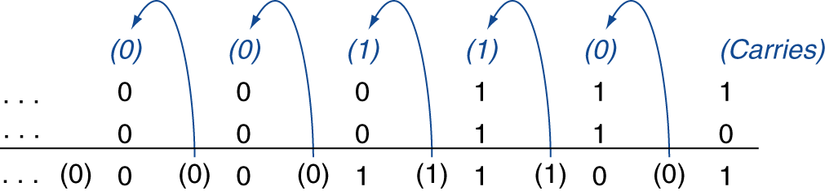
Integer Addition
Example: 7 + 6
§3.2 Addition and Subtraction
Overflow if result out of range
Adding +ve and –ve operands, no overflow
Adding two +ve operands
Overflow if result sign is 1
Adding two –ve operands
Overflow if result sign is 0

Slide 4
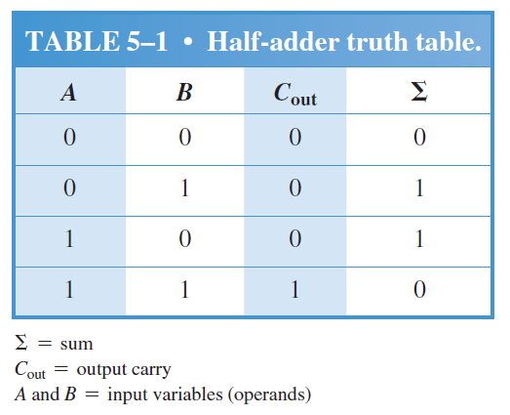
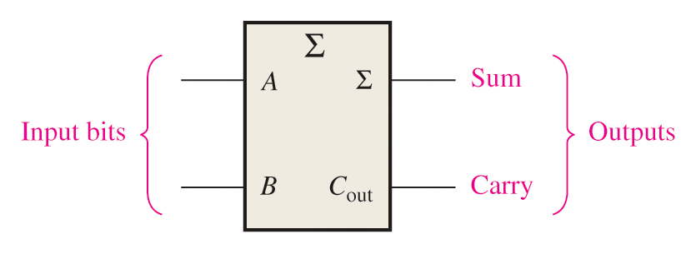
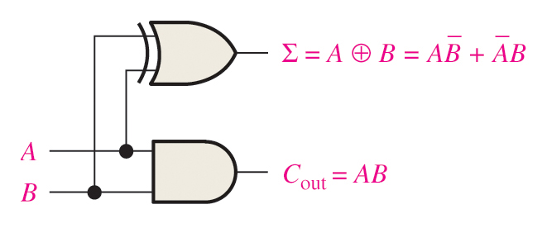
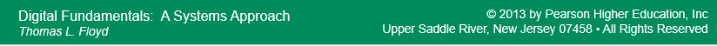
Half-Adders
Basic rules of binary addition are performed by a half adder, which accepts two binary inputs (A and B) and provides two binary outputs (Carry-out and Sum).
The logic symbol and equivalent circuit are:

Slide 5
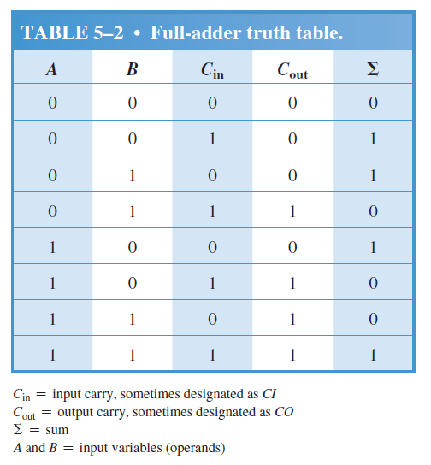
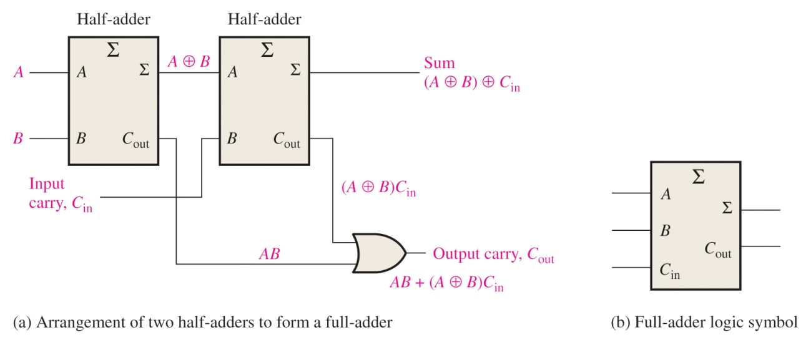
Full-Adders
A full adder accepts three binary inputs (A, B, and Carry-in) and provides two binary outputs (Carry-out and Sum). The truth table summarizes the operation.
A full-adder can be constructed from two half adders as shown:

Slide 6
Full-Adders
Σ
Σ
1
Σ
Σ
0
Sum
1
A
A
B
0
1
0
C_{out}
B
C_{out}
1
C_{out}
For the given inputs, determine the intermediate and final outputs of the full adder.
1
The first half-adder has inputs of 1 and 0; therefore the Sum =1 and the Carry out = 0.
The second half-adder has inputs of 1 and 1; therefore the Sum = 0 and the Carry out = 1.
The OR gate has inputs of 1 and 0, therefore the final carry out = 1.

Slide 7
Integer Subtraction
Add negation of second operand
For negative operand, use 2’s complement
Example: 7 – 6 = 7 + (–6)
+7: 0000 0000 … 0000 0111 –6: 1111 1111 … 1111 1010 +1: 0000 0000 … 0000 0001
Remember 2’s complement
Complement each bit (1 to 0, 0 to 1) and add 1
6 = 0000 0000 0000 0000 0000 0000 0000 0110
-6 = 1111 1111 1111 1111 1111 1111 1111 1010

Slide 8
Integer Subtraction
Example: 7 – 6 = 7 + (–6)
+7: 0000 0000 … 0000 0111 –6: 1111 1111 … 1111 1010 +1: 0000 0000 … 0000 0001
Overflow if result out of range
Subtracting two +ve or two –ve operands, no overflow
Subtracting +ve from –ve operand
Overflow if result sign is 0
Subtracting –ve from +ve operand
Overflow if result sign is 1

Slide 9
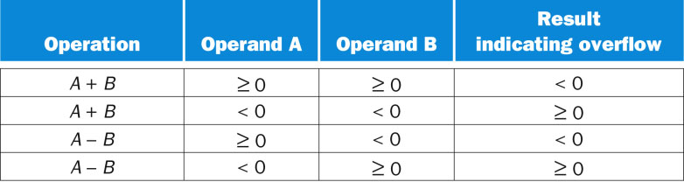
Overflow conditions for addition and subtraction
Case 1
A = 0111 0000 0000 0000 0000 0000 0000 0000
B = 0101 0000 0000 0000 0000 0000 0000 0000
Sum = 1100 0000 0000 0000 0000 0000 0000 0000
Case 1
A = 1879048192
B = 1342177280
Sum = -1073741824
Case 2
A = 1111 0000 0000 0000 0000 0000 0000 0000
B = 1000 1000 0000 0000 0000 0000 0000 0000
Sum = 0111 1000 0000 0000 0000 0000 0000 0000
Case 2
A = -268435456
B = -2013265920
Sum = 2013265920

Slide 10
Overflow conditions for addition and subtraction
Case 3
A = 0111 0000 0000 0000 0000 0000 0000 0000
B = 1101 0000 0000 0000 0000 0000 0000 0000
Case 3
A = 1879048192
B = -805306368
Sub = -1610612736
A = 0111 0000 0000 0000 0000 0000 0000 0000
B” = 0011 0000 0000 0000 0000 0000 0000 0000
Sum = 1010 0000 0000 0000 0000 0000 0000 0000

Slide 11
Overflow conditions for addition and subtraction
Case 4
A = 1111 0000 0000 0000 0000 0000 0000 0000
B = 0101 0000 0000 0000 0000 0000 0000 0000
Case 3
A = -268435456
B = 1342177280
Sub = 536870912
A = 1111 0000 0000 0000 0000 0000 0000 0000
B” = 1011 0000 0000 0000 0000 0000 0000 0000
Sum = 0010 0000 0000 0000 0000 0000 0000 0000

Slide 12
Dealing with Overflow in MIPS
We have seen that signed and two’s complement case(s) where overflow can occur.
For unsigned: since it is commonly used for memory addressing the overflows are ignored.
Thus, MIPS provides 2 choices:
Use add, addi and sub which cause exceptions on overflow.
Or, to use addu, addui and subu instructions which do not cause exception on overflow.

Slide 13
Dealing with Overflow …
Some languages (e.g., C, Java) ignore overflow
Other languages (e.g., Ada, Fortran) require raising an exception

Slide 14
Multiplication
§3.3 Multiplication
Start with long-multiplication approach
multiplicand
1000
× 1001
1000
0000
0000
1000
1001000
multiplier
product
Max length of product is the sum of operand lengths
Notes:
Note: for length-theory of the multiplier, check with decimal 99 x 99 = 9801,
Or for Hex, FF x FF =FE01.
Or, binary 1011 x 1101 = (11 x 13 in decimal) = 1000 1111 (143 in decimal)

Slide 15
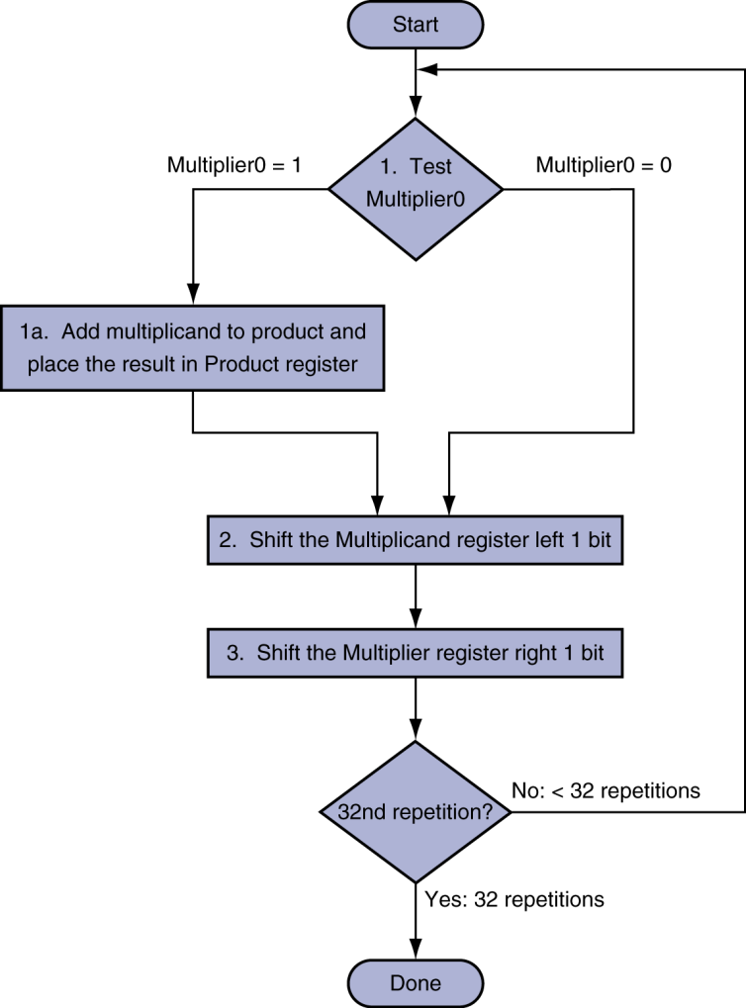
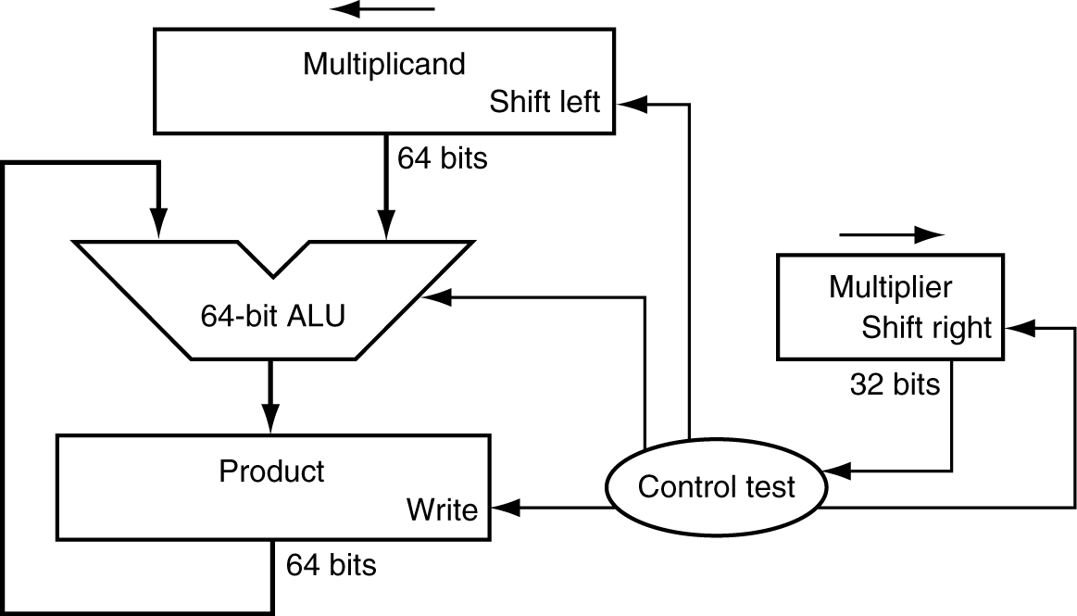
Multiplication Hardware
First number
Second number
Initially 0
If each operations requires one clock cycle, then for 3 operations applied to each 32 bits will require almost 100 clock cycle in total.
If these 3 operations are done in parallel then it will require 1/3 of this execution time.

Slide 16
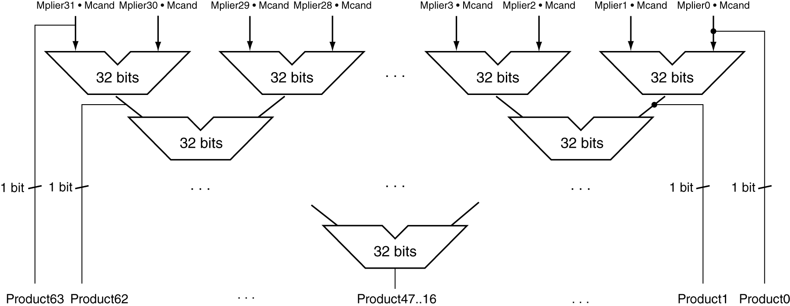
Faster Multiplier
Uses multiple adders
Cost/performance tradeoff
Can be pipelined
Several multiplication performed in parallel

Slide 17
Signed Multiplier
Convert the multiplier and multiplicand to positive numbers and remember the original signs.
Run for 31 iterations, leaving the signs out of calculation.
If the signs disagree then we need to negate the result.
Shifting steps extend the sign of product for signed numbers.
Finally, the lower word will have the 32-bit product.

Slide 18
MIPS Multiplication
Two 32-bit registers for product
HI: most-significant 32 bits
LO: least-significant 32-bits
Instructions
mult rs, rt / multu rs, rt
64-bit product in HI/LO
mfhi rd / mflo rd
Move from HI/LO to rd
Can test HI value to see if product overflows 32 bits
mul rd, rs, rt
Least-significant 32 bits of product –> rd

Slide 19
Division
Self Study
§3.4 Division
Check for 0 divisor
Long division approach
If divisor ≤ dividend bits
1 bit in quotient, subtract
Otherwise
0 bit in quotient, bring down next dividend bit
Restoring division
Do the subtract, and if remainder goes < 0, add divisor back
Signed division
Divide using absolute values
Adjust sign of quotient and remainder as required
quotient
dividend
1001
1000 1001010
-1000
10
101
1010
-1000
10
divisor
remainder
n-bit operands yield n-bit quotient and remainder

Slide 20
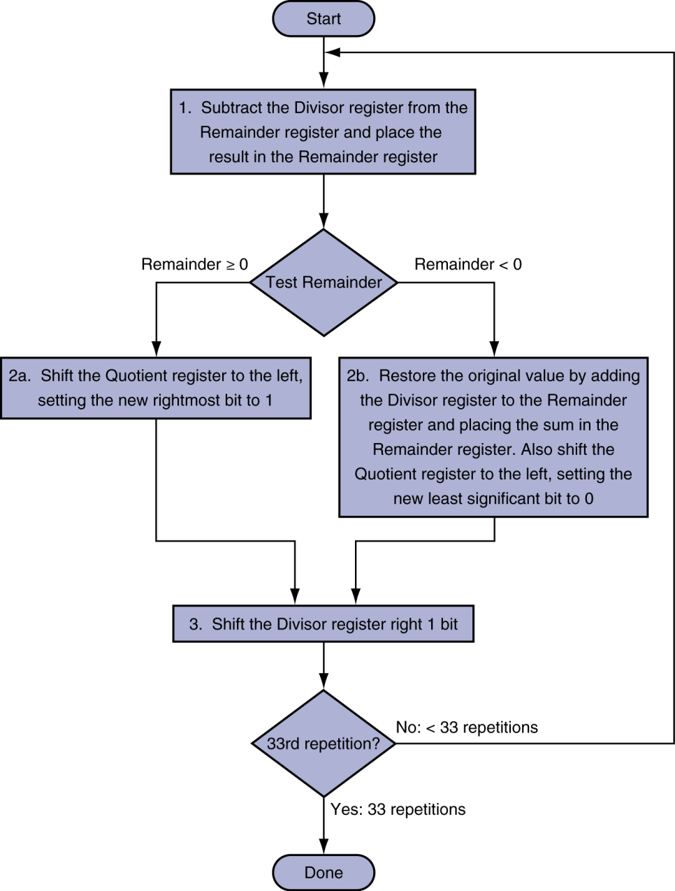
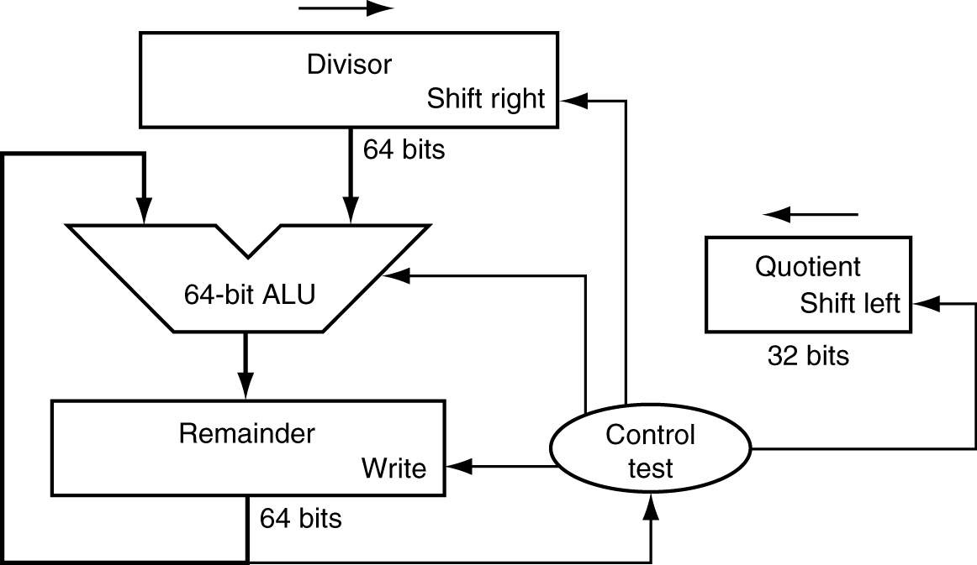
Division Hardware
Self Study
Initially divisor in left half
Initially dividend

Slide 21
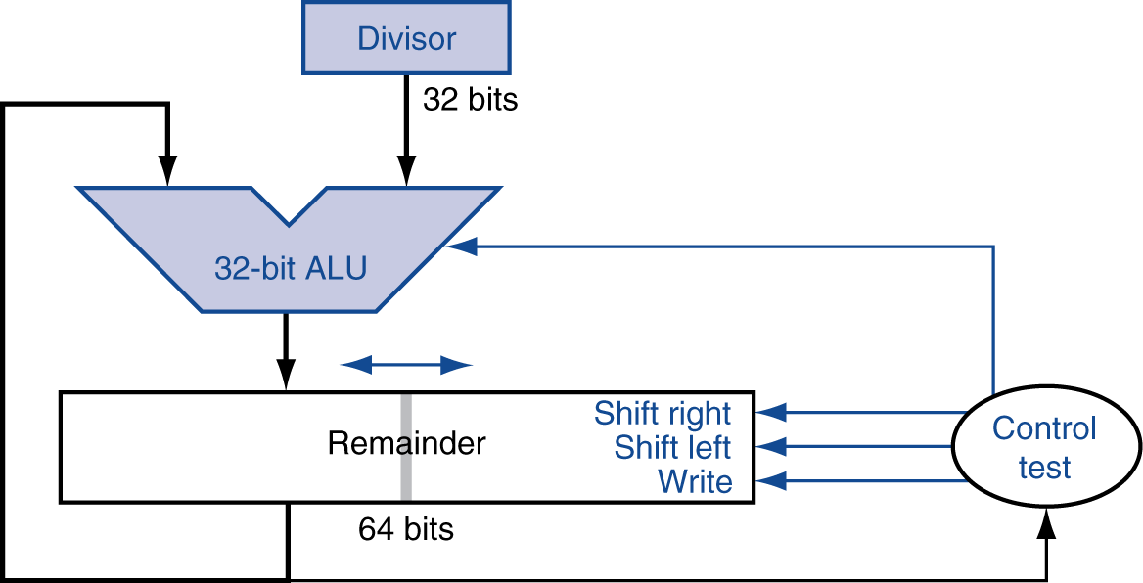
Optimized Divider
Self Study
Here, quotient is in the right half of the remainder register.
One cycle per partial-remainder subtraction
Looks a lot like a multiplier!
Same hardware can be used for both

Slide 22
MIPS Division
Use HI/LO registers for result
HI: 32-bit remainder ( rs mod rt)
LO: 32-bit quotient ( rs / rt )
Instructions
div rs, rt / divu rs, rt
No overflow or divide-by-0 checking
Software must perform checks if required
Use mfhi, mflo to access result

Slide 23
The Binary Number System
The binary number system is used in digital systems. Binary has only two symbols that are used to represent quantities: 0 and 1.
The column weights of binary numbers are powers of two that increase from right to left beginning with 2⁰ =1:
… 2⁵ 2⁴ 2³ 2² 2¹ 2⁰.
For fractional binary numbers, the column weights are negative powers of two that decrease from left to right:
… 2² 2¹ 2⁰ . 2⁻¹ 2⁻² 2⁻³ 2⁻⁴ …

Slide 24
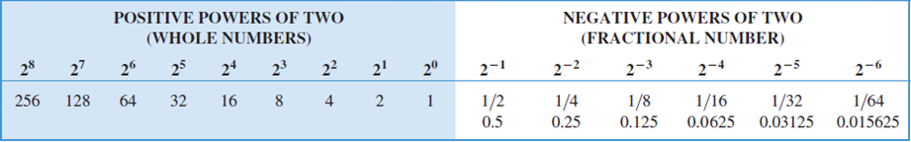
Binary Weights
The positional weights for binary numbers are assigned as shown below.

Slide 25
Binary-to-Decimal Conversion
The decimal equivalent of a binary number can be determined by adding the column values of all of the bits that are 1 and discarding all of the bits that are 0.
Convert the binary number 100101.01 to decimal.
Start by writing the column weights; then add the weights that correspond to each 1 in the number.
2⁵ 2⁴ 2³ 2² 2¹ 2⁰. 2⁻¹ 2⁻²
32 16 8 4 2 1 0.5 0.25
1 0 0 1 0 1. 0 1
32 +4 +1 +0.25 =
37.25

Slide 26
Decimal-to-Binary Conversions
You can convert a decimal whole number to binary by reversing the procedure. Write the decimal weight of each column and place 1’s in the columns that sum to the decimal number.
Convert the decimal number 49 to binary.
The column weights double in each position to the right. Write down column weights until the last number is larger than the one you want to convert.
2⁶ 2⁵ 2⁴ 2³ 2² 2¹ 2⁰
64 32 16 8 4 2 1
0 1 1 0 0 0 1

Slide 27
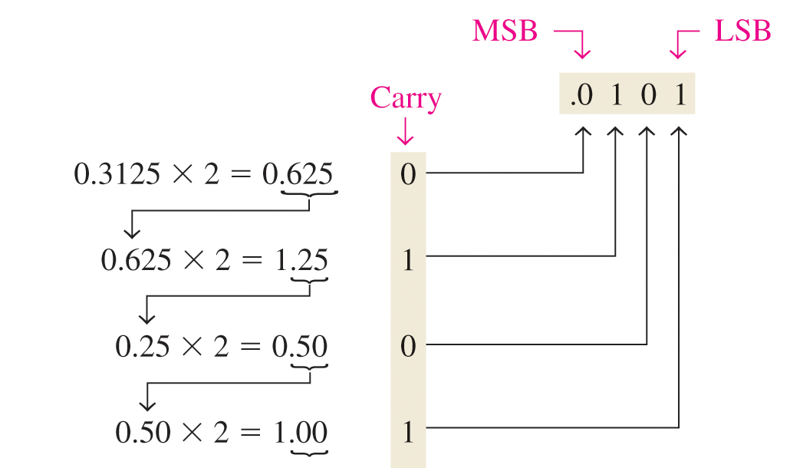
Decimal-to-Binary Conversions
You can convert a decimal fraction to binary by repeatedly multiplying the fractional results of successive multiplications by 2. The carries form the binary number.
Continue to the desired number of decimal places or stop when the fractional part is all zeros.

Slide 28
Floating Point
§3.5 Floating Point
Representation for non-integer numbers
Including very small and very large numbers
Like scientific notation
–2.34 × 10⁵⁶
+0.002 × 10^{–4}
+987.02 × 10⁹
In binary
±1.xxxxxxx₂ × 2^{yyyy}
Types float and double in C
normalized
not normalized

Slide 29
Floating Point
single: 8 bits double: 11 bits
single: 23 bits double: 52 bits
S
Exponent
Fraction
$$x=(−1)^{S}×(Fraction)×2^{Exponent}$$

Slide 30
Floating Point Standard
Defined by IEEE Std 754
Developed in response to divergence of representations
Portability issues for scientific code
Now almost universally adopted
Two representations
Single precision (32-bit)
Double precision (64-bit)

Slide 31
IEEE Floating-Point Format
single: 8 bits double: 11 bits
single: 23 bits double: 52 bits
S
Exponent
Fraction
$$x=(−1)^{S}×(1+Fraction)×2^{(Exponent−Bias)}$$
S: sign bit (0 ⇒ non-negative, 1 ⇒ negative)
1 + Fraction to make sure the number is scientific format.
Exponent: excess representation: actual exponent + Bias
Ensures exponent is unsigned
Single: Bias = 127; Double: Bias = 1023

Slide 32
Floating-Point Example
Represent –0.75
–0.75 = (–1)¹ × 1.1₂ × 2^{–1}
S = 1
Fraction = 1000…00₂
Exponent = –1 + Bias
Single: –1 + 127 = 126 = 01111110₂
Double: –1 + 1023 = 1022 = 01111111110₂
Single: 1011111101000…00
Double: 1011111111101000…00

Slide 33
Floating-Point Example
What number is represented by the single-precision float
11000000101000…00
S = 1
Fraction = 01000…00₂
Exponent = 10000001₂ = 129
x = (–1)¹ × (1 + 01₂) × 2^{(129 – 127)}
= (–1) × 1.25 × 2²
= –5.0

Slide 34
Single-Precision Range
Exponents 00000000 and 11111111 reserved
Smallest value (Normalized case)
Exponent: 00000001 ⇒ actual exponent = 1 – 127 = –126
Fraction: 000…00 ⇒ significand = 1.0
±1.0 × 2^{–126} ≈ ±1.2 × 10^{–38}
Largest value
exponent: 11111110 ⇒ actual exponent = 254 – 127 = +127
Fraction: 111…11 ⇒ significand ≈ 2.0
±2.0 × 2⁺¹²⁷ ≈ ±3.4 × 10⁺³⁸

Slide 35
Double-Precision Range
Exponents 0000…00 and 1111…11 reserved
Smallest value (Normalized case)
Exponent: 00000000001 ⇒ actual exponent = 1 – 1023 = –1022
Fraction: 000…00 ⇒ significand = 1.0
±1.0 × 2^{–1022} ≈ ±2.2 × 10^{–308}
Largest value
Exponent: 11111111110 ⇒ actual exponent = 2046 – 1023 = +1023
Fraction: 111…11 ⇒ significand ≈ 2.0
±2.0 × 2⁺¹⁰²³ ≈ ±1.8 × 10⁺³⁰⁸

Slide 36
Infinities and NaNs
Exponent = 111...1, Fraction = 000...0
±Infinity
Can be used in subsequent calculations, avoiding need for overflow check
Exponent = 111...1, Fraction ≠ 000...0
Not-a-Number (NaN)
Indicates illegal or undefined result
e.g., 0.0 / 0.0
Can be used in subsequent calculations

Slide 37
Floating-Point Addition
Consider a 4-digit decimal example
9.999 × 10¹ + 1.610 × 10^{–1}
1. Align decimal points
Shift number with smaller exponent
9.999 × 10¹ + 0.016 × 10¹
2. Add significands
9.999 × 10¹ + 0.016 × 10¹ = 10.015 × 10¹
3. Normalize result & check for over/underflow
1.0015 × 10²
4. Round and renormalize if necessary
1.002 × 10²

Slide 38
Floating-Point Addition
Now consider a 4-digit binary example
1.000₂ × 2^{–1} + –1.110₂ × 2^{–2} =>(0.5 + –0.4375)₁₀
1. Align binary points
Shift number with smaller exponent
1.000₂ × 2^{–1} + –0.111₂ × 2^{–1}
2. Add significands
1.000₂ × 2^{–1} + –0.111₂ × 2^{–1} = 0.001₂ × 2^{–1}
3. Normalize result & check for over/underflow
1.000₂ × 2^{–4}, with no over/underflow
4. Round and renormalize if necessary
1.000₂ × 2^{–4} (no change) => 0.0625

Slide 39
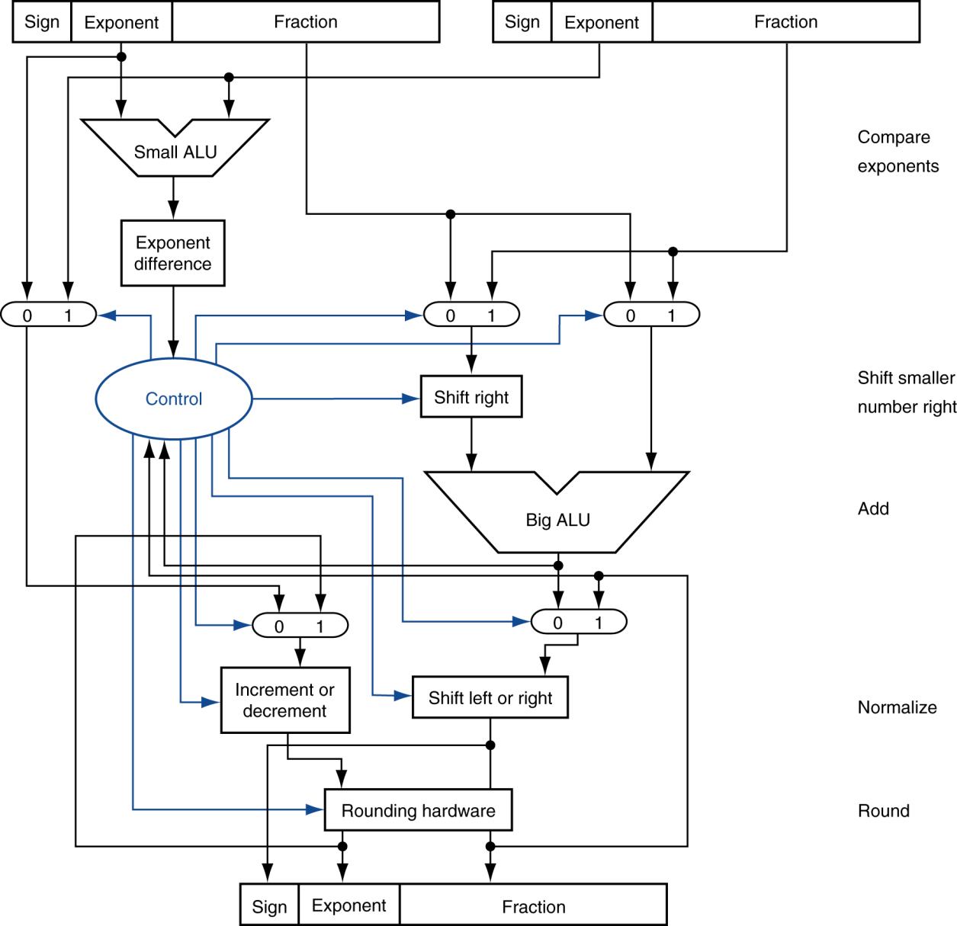
FP Adder Hardware
Self Study
Step 1
Step 2
Step 3
Step 4
Notes:
Note: Step 2 is “Add significands”

Slide 40
FP Adder Hardware
Self Study
Much more complex than integer adder
Doing it in one clock cycle would take too long
Much longer than integer operations
Slower clock would penalize all instructions
FP adder usually takes several cycles
Can be pipelined

Slide 41
Floating-Point Multiplication
Consider a 4-digit decimal example
1.110 × 10¹⁰ × 9.200 × 10^{–5}
1. Add exponents
New exponent = 10 + –5 = 5
2. Multiply significands
1.110 × 9.200 = 10.212 ⇒ 10.212 × 10⁵
3. Normalize result & check for over/underflow
1.0212 × 10⁶
4. Round and renormalize (if necessary)
1.021 × 10⁶
5. Determine sign of result from signs of operands
+1.021 × 10⁶

Slide 42
Floating-Point Multiplication
Now consider a 4-digit binary example
1.000₂ × 2^{–1} × –1.110₂ × 2^{–2} => (0.5 × –0.4375)
1. Add exponents
Unbiased: –1 + –2 = –3 (Real exponent)
Biased: (–1 + –2) + 127 => –3 + 127 = 124
2. Multiply significands
1.000₂ × 1.110₂ = 1.110₂ ⇒ 1.110₂ × 2^{–3}
3. Normalize result & check for over/underflow
1.110₂ × 2^{–3} (no change) with no over/underflow
4. Round and renormalize if necessary
1.110₂ × 2^{–3} (no change)
5. Determine sign: +ve × –ve ⇒ –ve
–1.110₂ × 2^{–3} = –0.21875

Slide 43
FP Arithmetic Hardware
Self Study
FP multiplier is of similar complexity to FP adder
But uses a multiplier for significands instead of an adder
FP arithmetic hardware usually does
Addition, subtraction, multiplication, division, reciprocal, square-root
FP ↔ integer conversion
Operations usually takes several cycles
Can be pipelined

Slide 44
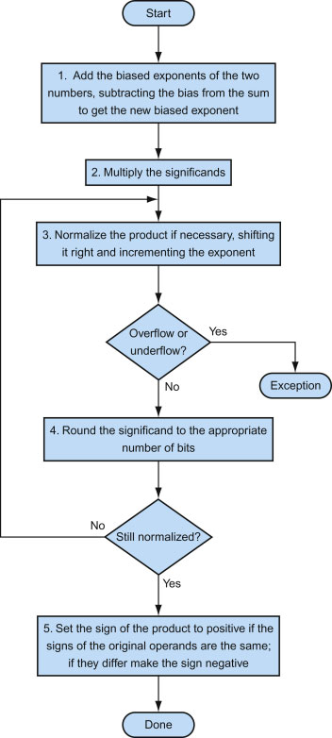
Floating-point multiplication
Self Study
FIGURE: Floating-point multiplication. The normal path is to execute steps 3 and 4 once, but if rounding causes the sum to be unnormalized, we must repeat step 3.
44
Copyright © 2014 Elsevier Inc. All rights reserved.

Slide 45
FP Instructions in MIPS
FP hardware is coprocessor 1
Adjunct processor that extends the ISA
Separate FP registers
32 single-precision: $f0, $f1, … $f31
Paired for double-precision: $f0/$f1, $f2/$f3, …
Release 2 of MIPs ISA supports 32 × 64-bit FP reg’s
FP instructions operate only on FP registers
Programs generally don’t do integer ops on FP data, or vice versa
More registers with minimal code-size impact
FP load and store instructions
lwc1, ldc1, swc1, sdc1
e.g., ldc1 $f8, 32($sp)
Notes:
Note: “ldc1 $f8, 32($sp)” is a 64 bit operation (since it is ‘ld’ or ‘load double’) so, another register will be needed with $f8 and it should be $f9 – it is basically ‘even-odd’ pair.

Slide 46
FP Instructions in MIPS
Single-precision arithmetic
add.s, sub.s, mul.s, div.s
e.g., add.s $f0, $f1, $f6
Double-precision arithmetic
add.d, sub.d, mul.d, div.d
e.g., mul.d $f4, $f4, $f6
Single- and double-precision comparison
c.xx.s, c.xx.d (xx is eq, neq, lt, le, gt, ge)
Sets FP condition-code bit (if correct “true”, otherwise “false”)
e.g. c.lt.s $f3, $f4
Branch on FP condition code true or false
Bc1t (branch if true), bc1f (branch if false)
e.g., bc1t TargetLabel
Notes:
c. => compare
c.lt.d $f0, $f2 # condition code = $f0 < $f2
bc1t TargetLabet #Branch if $f0 < $f2 is TRUE

Slide 47
FP Instructions in MIPS
Conditional jumps are performed in two stages
Comparison of FP values sets a code in a special register
Branch instructions jump depending on the value of the code
Comparison
c.eq.s $f2, $f4 #(if $f2 == $f4 then code = 1 else code = 0)
c.le.s $f2, $f4 #(if $f2 <= $f4 then code = 1 else code = 0)
c.lt.s $f2, $f4 #(if $f2 < $f4 then code = 1 else code = 0)
Branches
bc1f label #(if code == 0 then jump to label)
bc1t label #(if code == 1 then jump to label)

Slide 48
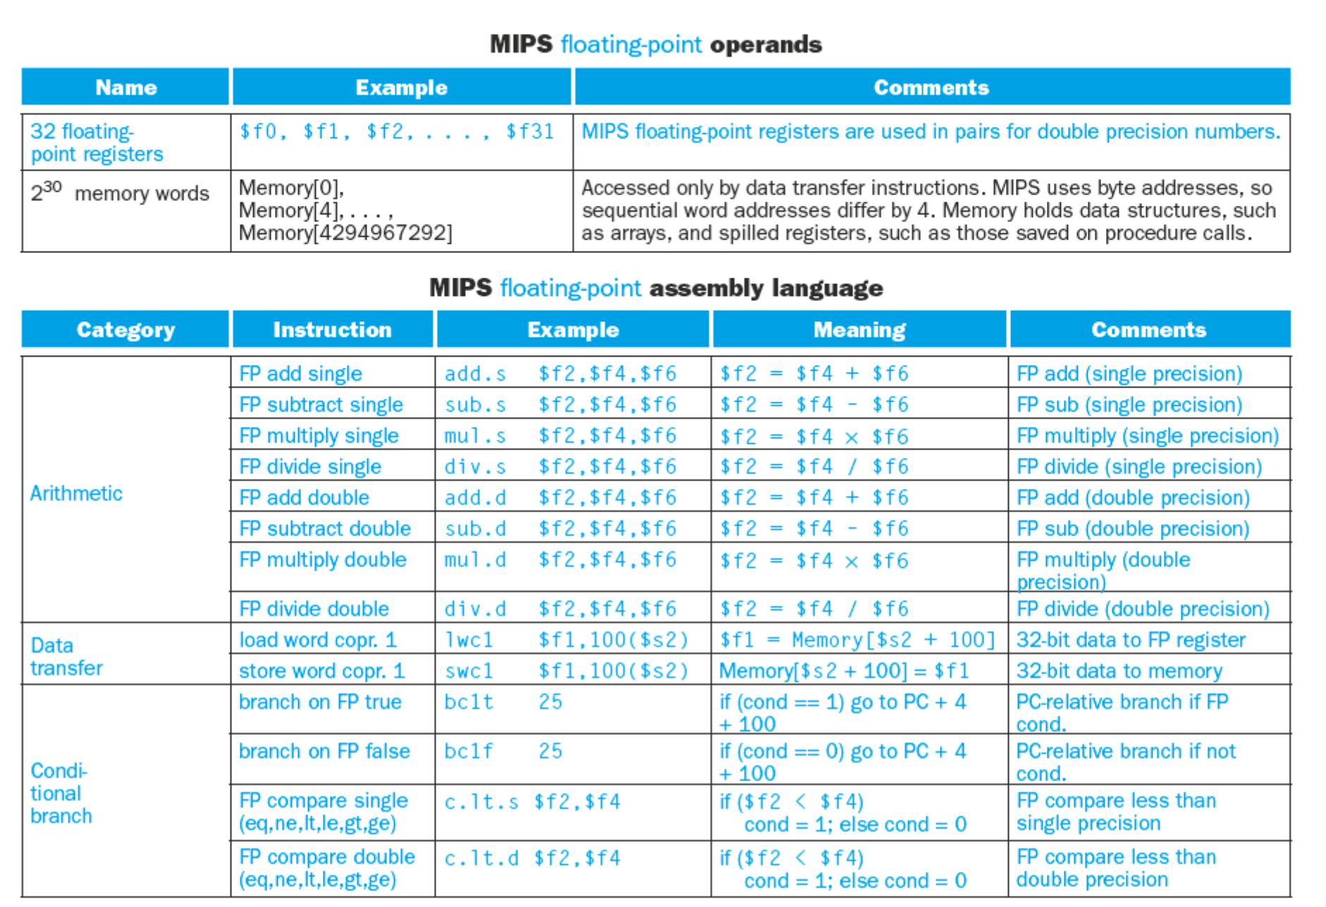

Slide 49
FP Example: °F to °C
C code:
float f2c (float fahr) { return ((5.0/9.0)*(fahr - 32.0)); }
fahr in $f12, result in $f0, literals in global memory space
Compiled MIPS code:
f2c: lwc1 $f16, const5($gp) #$f16 = 5.0 lwc1 $f18, const9($gp) #$f18 = 9.0 div.s $f16, $f16, $f18 #$f16 = 5.0/9.0 lwc1 $f18, const32($gp)#$f18= 32.0 sub.s $f18, $f12, $f18 #$f18=fahr-32.0 mul.s $f0, $f16, $f18 #$f0= output result jr $ra

Slide 50
FP Example: Array Multiplication
Self Study
X = X + Y × Z
All 32 × 32 matrices, 64-bit double-precision elements
C code:
void mm (double x[][], double y[][], double z[][]) { int i, j, k; for (i = 0; i! = 32; i = i + 1) for (j = 0; j! = 32; j = j + 1) for (k = 0; k! = 32; k = k + 1) x[i][j] = x[i][j] + y[i][k] * z[k][j]; }
Addresses of x, y, z in $a0, $a1, $a2, and i, j, k in $s0, $s1, $s2
Notes:
mm = matrix mult.

Slide 51
FP Example: Array Multiplication
Self Study
MIPS code:
li $t1, 32 # $t1 = 32 (row size/loop end) li $s0, 0 # i = 0; initialize 1st for loop L1: li $s1, 0 # j = 0; restart 2nd for loop L2: li $s2, 0 # k = 0; restart 3rd for loop sll $t2, $s0, 5 # $t2 = i * 32 (size of row of x) addu $t2, $t2, $s1 # $t2 = i * size(row) + j sll $t2, $t2, 3 # $t2 = byte offset of [i][j] addu $t2, $a0, $t2 # $t2 = byte address of x[i][j] l.d $f4, 0($t2) # $f4 = 8 bytes of x[i][j] L3: sll $t0, $s2, 5 # $t0 = k * 32 (size of row of z) addu $t0, $t0, $s1 # $t0 = k * size(row) + j sll $t0, $t0, 3 # $t0 = byte offset of [k][j] addu $t0, $a2, $t0 # $t0 = byte address of z[k][j] l.d $f16, 0($t0) # $f16 = 8 bytes of z[k][j] …

Slide 52
FP Example: Array Multiplication
Self Study
… sll $t0, $s0, 5 # $t0 = i*32 (size of row of y) addu $t0, $t0, $s2 # $t0 = i*size(row) + k sll $t0, $t0, 3 # $t0 = byte offset of [i][k] addu $t0, $a1, $t0 # $t0 = byte address of y[i][k] l.d $f18, 0($t0) # $f18 = 8 bytes of y[i][k] mul.d $f16, $f18, $f16 # $f16 = y[i][k] * z[k][j] add.d $f4, $f4, $f16 # f4=x[i][j] + y[i][k]*z[k][j] addiu $s2, $s2, 1 # $k k + 1 bne $s2, $t1, L3 # if (k != 32) go to L3 s.d $f4, 0($t2) # x[i][j] = $f4 addiu $s1, $s1, 1 # $j = j + 1 bne $s1, $t1, L2 # if (j != 32) go to L2 addiu $s0, $s0, 1 # $i = i + 1 bne $s0, $t1, L1 # if (i != 32) go to L1

Slide 53
Accurate Arithmetic
IEEE Std 754 specifies additional rounding control
Extra bits of precision (guard, round, sticky)
Choice of rounding modes
Allows programmer to fine-tune numerical behavior of a computation
Not all FP units implement all options
Most programming languages and FP libraries just use defaults
Trade-off between hardware complexity, performance, and market requirements
Notes:
IEEE 754 offers several modes of rounding to let the programmer pick the desired approximation.
For rounding hardware holds extra bits in calculation (which can be used in the intermediate calculation).
If your intermediate result had to be truncated to the exact number of digits, there would be no opportunity to round.
Thus, IEEE 754 keeps two extra bit on the right during intermediate additions, called guard(G) and round (R), respectively.
Sticky bit allows the computer to see the difference between 0.50…00 (decimal) and 0.50…01 (decimal).

Slide 54
Accurate Arithmetic
Example: Rounding with Guard Digits
Add 2.56_{ten} x 10⁰ to 2.34_{ten} x 10²
Assume, we have 3 significant decimal digits
With guard and round digits | Without guard and round digits
2.3400_{ten} + 0.0256_{ten} ------------------------ 2.3656_{ten} Thus, sum = 2.3656_{ten} x 10². Here, we have two digits to round: we can round down 0 to 49 and round up 51 to 99, while 50 is the tiebreaker. Thus, finally, sum =2.37_{ten} x 10². | 2.34_{ten} + 0.02_{ten} ------------------------ 2.36_{ten} Thus, sum = 2.36_{ten} x 10². Here, the final sum remains the same, that is 2.36_{ten} x 10².

Slide 55
Subword Parallellism
Self Study
Graphics and audio applications can take advantage of performing simultaneous operations on short vectors
Example: 128-bit adder:
Sixteen 8-bit adds
Eight 16-bit adds
Four 32-bit adds
Also called data-level parallelism, vector parallelism, or Single Instruction, Multiple Data (SIMD)
§3.6 Parallelism and Computer Arithmetic: Subword Parallelism

Slide 56
x86 FP Architecture
Self Study
Originally based on 8087 FP coprocessor
8 × 80-bit extended-precision registers
Used as a push-down stack
Registers indexed from TOS: ST(0), ST(1), …
FP values are 32-bit or 64 in memory
Converted on load/store of memory operand
Integer operands can also be converted on load/store
Very difficult to generate and optimize code
Result: poor FP performance
§3.7 Real Stuff: Streaming SIMD Extensions and AVX in x86

Slide 57
x86 FP Instructions
Self Study
Data transfer | Arithmetic | Compare | Transcendental
FILD mem/ST(i) FISTP mem/ST(i) FLDPI FLD1 FLDZ | FIADDP mem/ST(i) FISUBRP mem/ST(i) FIMULP mem/ST(i) FIDIVRP mem/ST(i) FSQRT FABS FRNDINT | FICOMP FIUCOMP FSTSW AX/mem | FPATAN F2XMI FCOS FPTAN FPREM FPSIN FYL2X
Optional variations
I: integer operand
P: pop operand from stack
R: reverse operand order
But not all combinations allowed

Slide 58
Streaming SIMD Extension 2 (SSE2)
Self Study
Adds 4 × 128-bit registers
Extended to 8 registers in AMD64/EM64T
Can be used for multiple FP operands
2 × 64-bit double precision
4 × 32-bit double precision
Instructions operate on them simultaneously
Single-Instruction Multiple-Data

Slide 59
Matrix Multiply
Self Study
Unoptimized code:
1. void dgemm (int n, double* A, double* B, double* C)
2. {
3. for (int i = 0; i < n; ++i)
4. for (int j = 0; j < n; ++j)
5. {
6. double cij = C[i+j*n]; /* cij = C[i][j] */
7. for(int k = 0; k < n; k++ )
8. cij += A[i+k*n] * B[k+j*n]; /* cij += A[i][k]*B[k][j] */
9. C[i+j*n] = cij; /* C[i][j] = cij */
10. }
11. }
§3.8 Going Faster: Subword Parallelism and Matrix Multiply

Slide 60
Matrix Multiply
Self Study
x86 assembly code:
1. vmovsd (%r10),%xmm0 # Load 1 element of C into %xmm0
2. mov %rsi,%rcx # register %rcx = %rsi
3. xor %eax,%eax # register %eax = 0
4. vmovsd (%rcx),%xmm1 # Load 1 element of B into %xmm1
5. add %r9,%rcx # register %rcx = %rcx + %r9
6. vmulsd (%r8,%rax,8),%xmm1,%xmm1 # Multiply %xmm1, element of A
7. add $0x1,%rax # register %rax = %rax + 1
8. cmp %eax,%edi # compare %eax to %edi
9. vaddsd %xmm1,%xmm0,%xmm0 # Add %xmm1, %xmm0
10. jg 30 <dgemm+0x30> # jump if %eax > %edi
11. add $0x1,%r11d # register %r11 = %r11 + 1
12. vmovsd %xmm0,(%r10) # Store %xmm0 into C element
§3.8 Going Faster: Subword Parallelism and Matrix Multiply

Slide 61
Matrix Multiply
Self Study
Optimized C code:
1. #include <x86intrin.h>
2. void dgemm (int n, double* A, double* B, double* C)
3. {
4. for ( int i = 0; i < n; i+=4 )
5. for ( int j = 0; j < n; j++ ) {
6. __m256d c0 = _mm256_load_pd(C+i+j*n); /* c0 = C[i][j] */
7. for( int k = 0; k < n; k++ )
8. c0 = _mm256_add_pd(c0, /* c0 += A[i][k]*B[k][j] */
9. _mm256_mul_pd(_mm256_load_pd(A+i+k*n),
10. _mm256_broadcast_sd(B+k+j*n)));
11. _mm256_store_pd(C+i+j*n, c0); /* C[i][j] = c0 */
12. }
13. }
§3.8 Going Faster: Subword Parallelism and Matrix Multiply

Slide 62
Matrix Multiply
Self Study
Optimized x86 assembly code:
1. vmovapd (%r11),%ymm0 # Load 4 elements of C into %ymm0
2. mov %rbx,%rcx # register %rcx = %rbx
3. xor %eax,%eax # register %eax = 0
4. vbroadcastsd (%rax,%r8,1),%ymm1 # Make 4 copies of B element
5. add $0x8,%rax # register %rax = %rax + 8
6. vmulpd (%rcx),%ymm1,%ymm1 # Parallel mul %ymm1,4 A elements
7. add %r9,%rcx # register %rcx = %rcx + %r9
8. cmp %r10,%rax # compare %r10 to %rax
9. vaddpd %ymm1,%ymm0,%ymm0 # Parallel add %ymm1, %ymm0
10. jne 50 <dgemm+0x50> # jump if not %r10 != %rax
11. add $0x1,%esi # register % esi = % esi + 1
12. vmovapd %ymm0,(%r11) # Store %ymm0 into 4 C elements
§3.8 Going Faster: Subword Parallelism and Matrix Multiply

Slide 63
Right Shift and Division
Left shift by i places multiplies an integer by 2^{i}
Right shift divides by 2^{i}?
Only for unsigned integers
For signed integers
Arithmetic right shift (sra): replicate the sign bit
e.g., –5 / 4
11111011₂ >> 2 = 11111110₂ = –2
Rounds toward –∞
c.f. 11111011₂ >>> 2 = 00111110₂ = +62 (srl)
§3.9 Fallacies and Pitfalls
Notes:
NOTE:
srl: shift right logical, >>>
sra: shift right arithmetic, >>

Slide 64
Associativity
Parallel programs may interleave operations in unexpected orders
Assumptions of associativity may fail
Need to validate parallel programs under varying degrees of parallelism

Slide 65
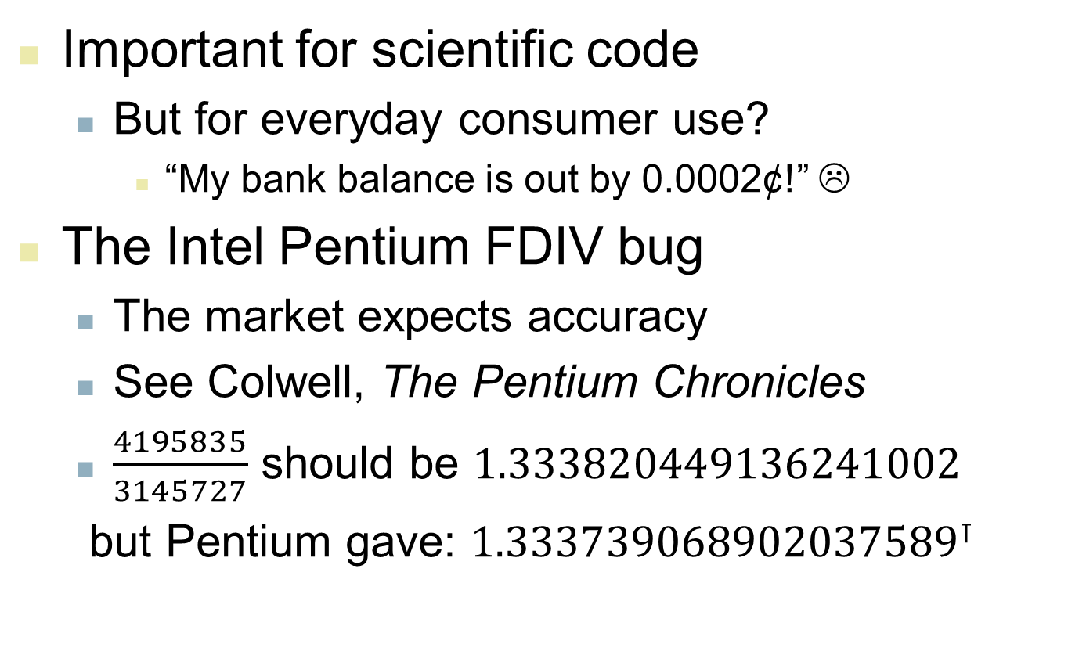
Who Cares About FP Accuracy?
Notes:
⊺ Ref: wiki

Slide 66
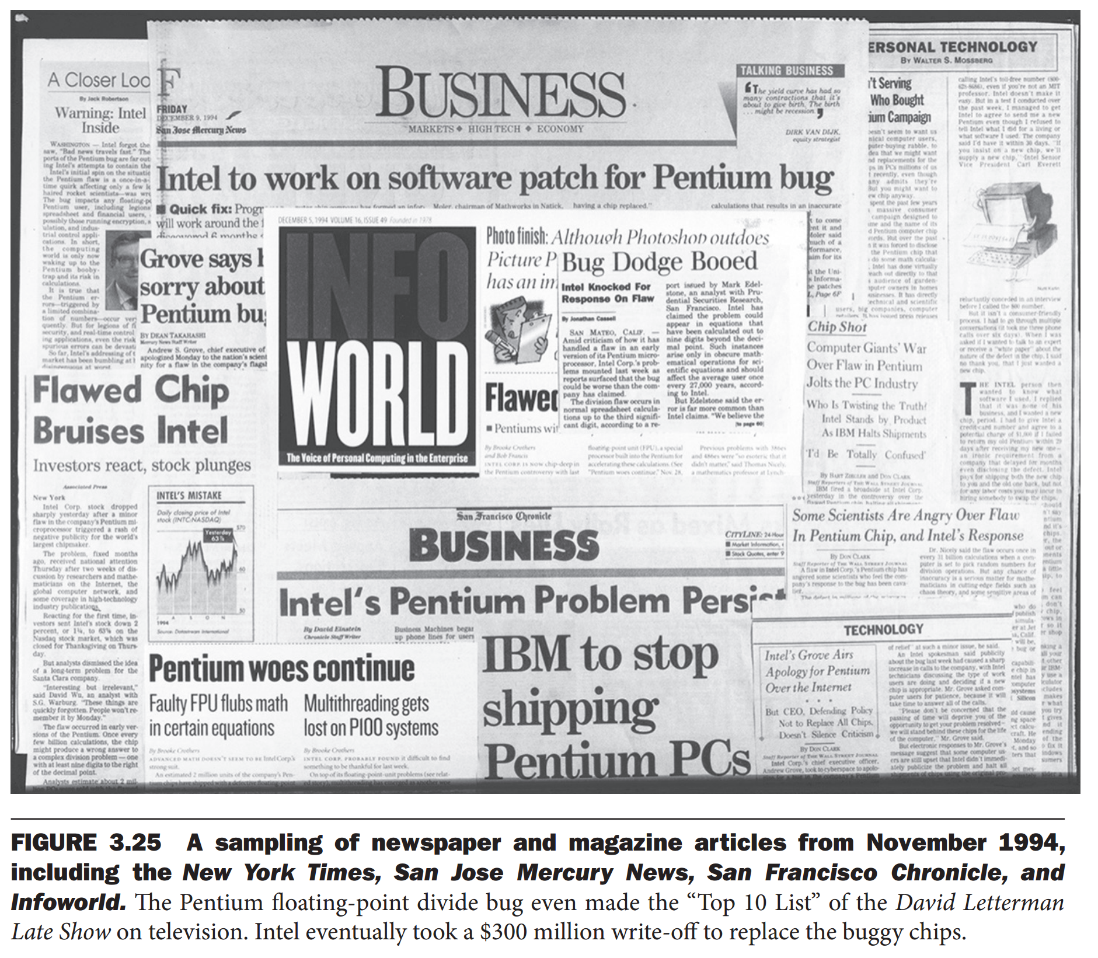
Notes:
⊺ Ref: wiki

Slide 67
Concluding Remarks
Bits have no inherent meaning
Interpretation depends on the instructions applied
Computer representations of numbers
Finite range and precision
Need to account for this in programs
§3.9 Concluding Remarks

Slide 68
Concluding Remarks
ISAs support arithmetic
Signed and unsigned integers
Floating-point approximation to reals
Bounded range and precision
Operations can overflow and underflow
MIPS ISA
Core instructions: 54 most frequently used
100% of SPECINT, 97% of SPECFP
Other instructions: less frequent
--- x ---

